Slide 1
About data Filip Krasniqi & Jocelyne Elias

Slide 2
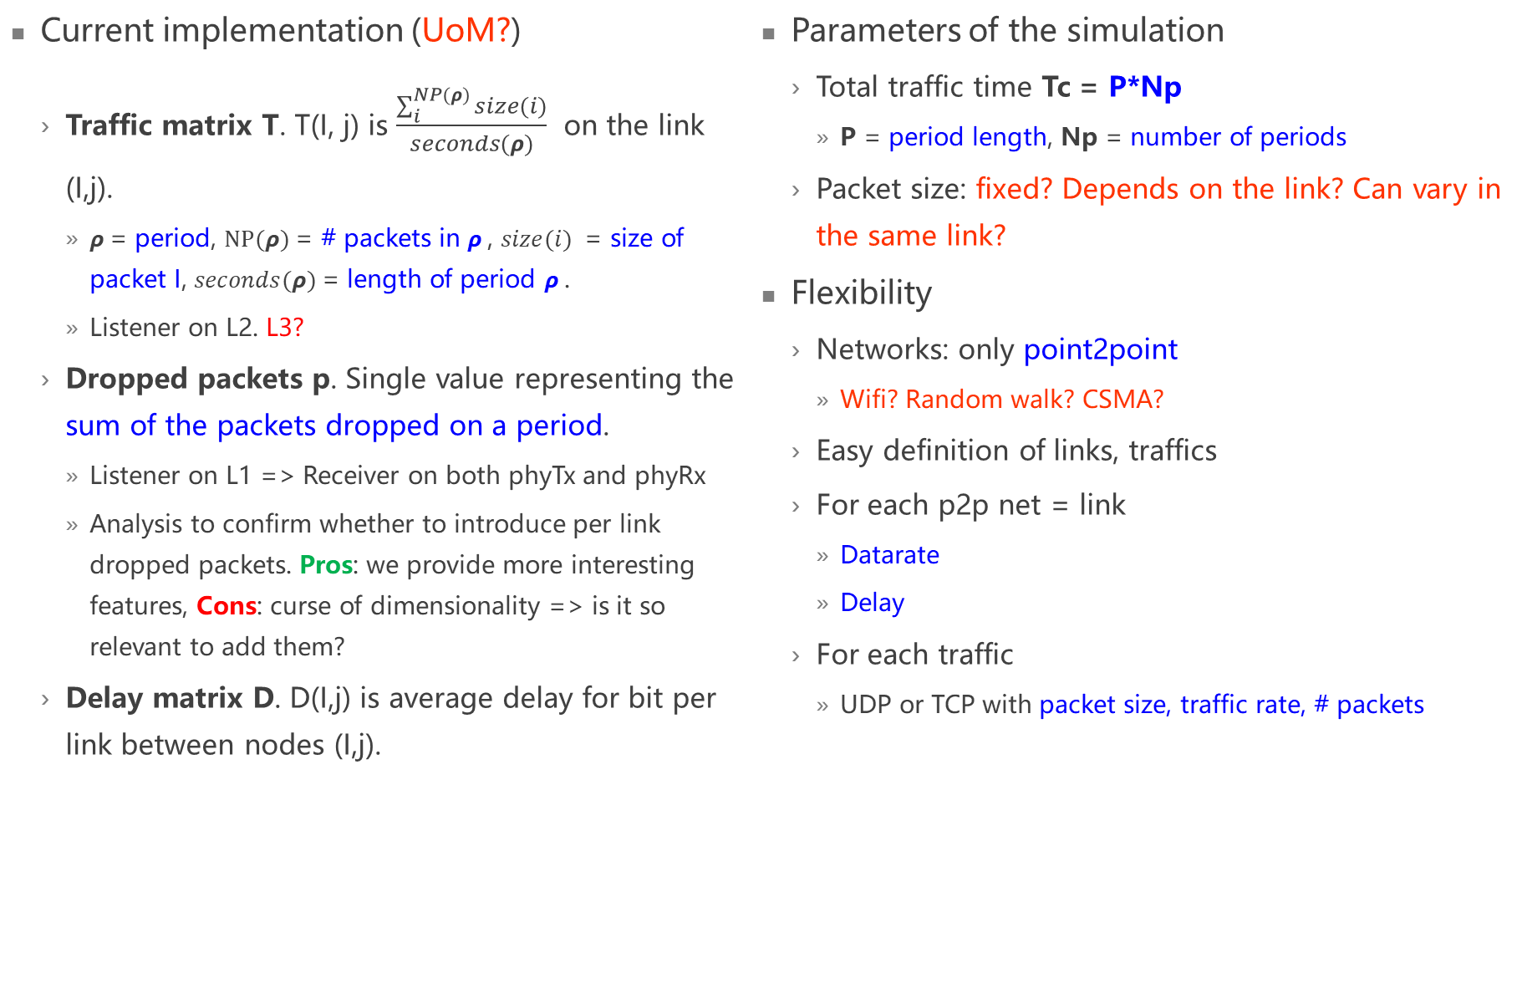
Ns3
Current implementation (UoM?)
Traffic matrix T. T(I, j) is $\frac{\sum_{i}^{NP(ρ)}{size(i)}}{seconds(ρ)}$ on the link (I,j).
$ρ$= period, $NP(ρ)$= # packets in $ρ$, $size(i)$ = size of packet I, $seconds(ρ)$= length of period $ρ$.
Listener on L2. L3?
Dropped packets p. Single value representing the sum of the packets dropped on a period.
Listener on L1 => Receiver on both phyTx and phyRx
Analysis to confirm whether to introduce per link dropped packets. Pros: we provide more interesting features, Cons: curse of dimensionality => is it so relevant to add them?
Delay matrix D. D(I,j) is average delay for bit per link between nodes (I,j).
Parameters of the simulation
Total traffic time Tc = P*Np
P = period length, Np = number of periods
Packet size: fixed? Depends on the link? Can vary in the same link?
Flexibility
Networks: only point2point
Wifi? Random walk? CSMA?
Easy definition of links, traffics
For each p2p net = link
Datarate
Delay
For each traffic
UDP or TCP with packet size, traffic rate, # packets
Notes:
Parameters of the simulation can vary what we learn. Obs: The delay function can be different depending on the communication itself => so the model should be able to learn the communication from the data, or we provide information about the communication itself (required during inference). That’s why I consider learning over time to be relevant, but other suggestions are welcome.
Here we are providing data => we always need to consider what is better for when they are used, aka, the easier we can provide those data in input, the better.

Slide 3
Ns3
Improvements
Information regarding the traffic
Traffic distribution
Intensity
Queue state
Information regarding the network
Output queue size per link
Adjacency matrix for GCN
Others?
Keep same program and read network, traffic, simulation from file
Notes:
Only way I know to get info is with tracing. How to export information of network, routing, … ? Ask for basic guidelines but I will search

